Slide 1
Challenge - 6 A lot can happen over fitness ! (Web App)
By
J . Megala

Slide 2

workflow
Dashboard
yes
Leaderboard
login
User profile
no
logout
Database
Register
Events
Map

Slide 3
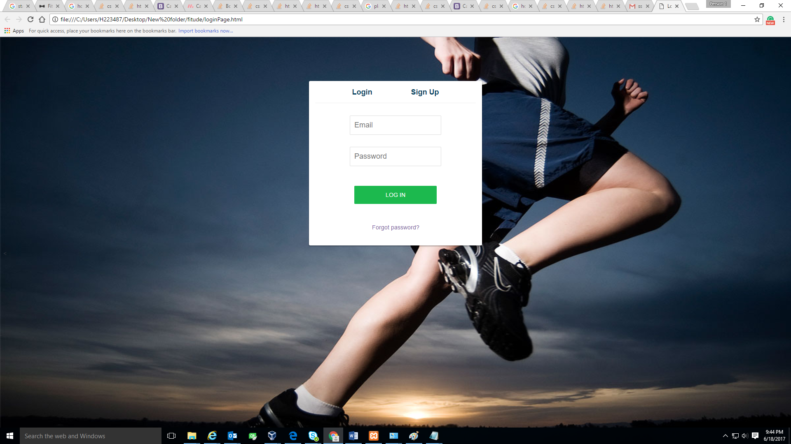

Slide 4
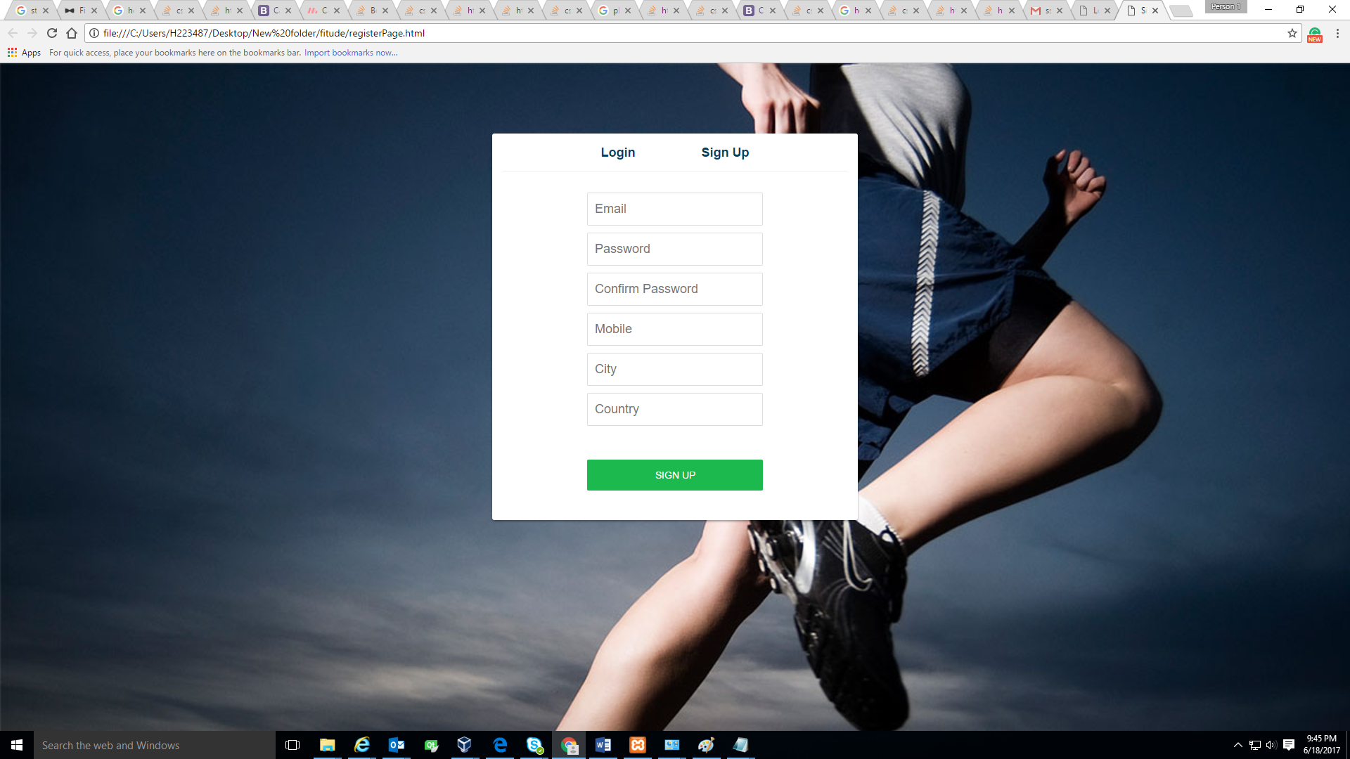

Slide 5
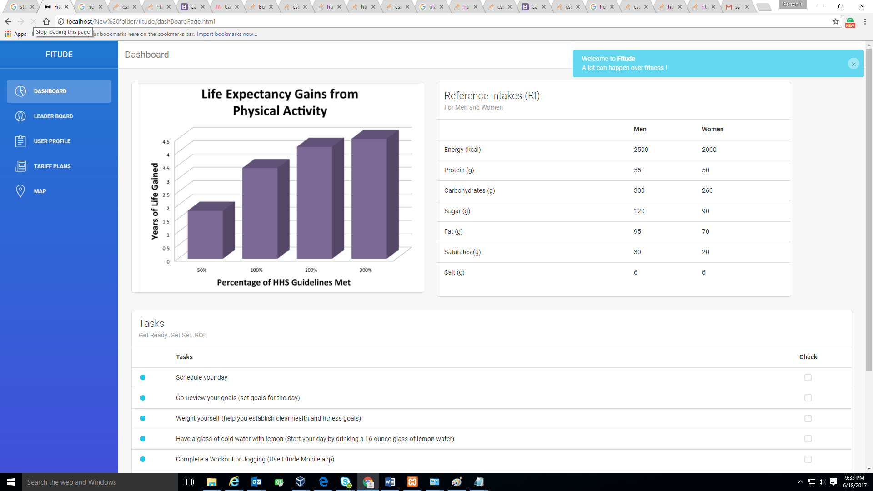

Slide 6
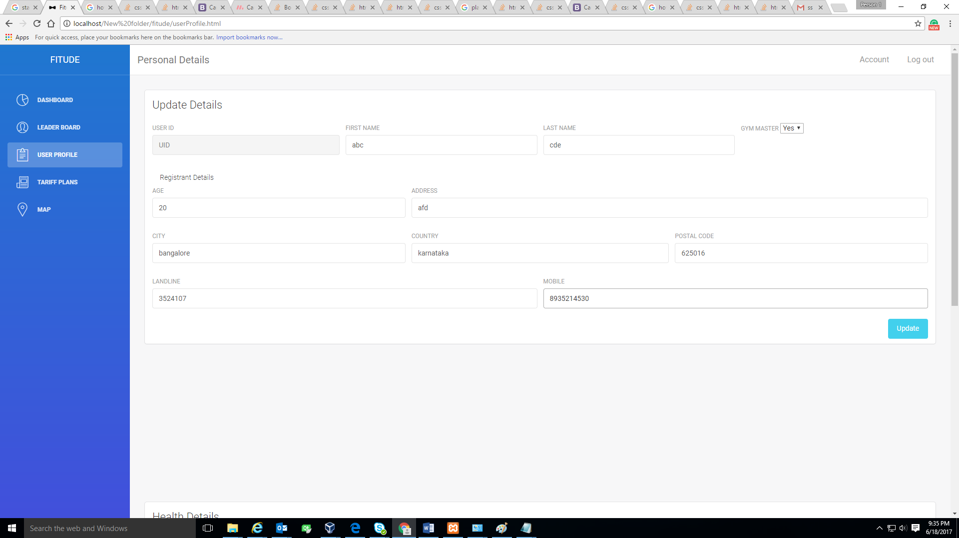

Slide 7
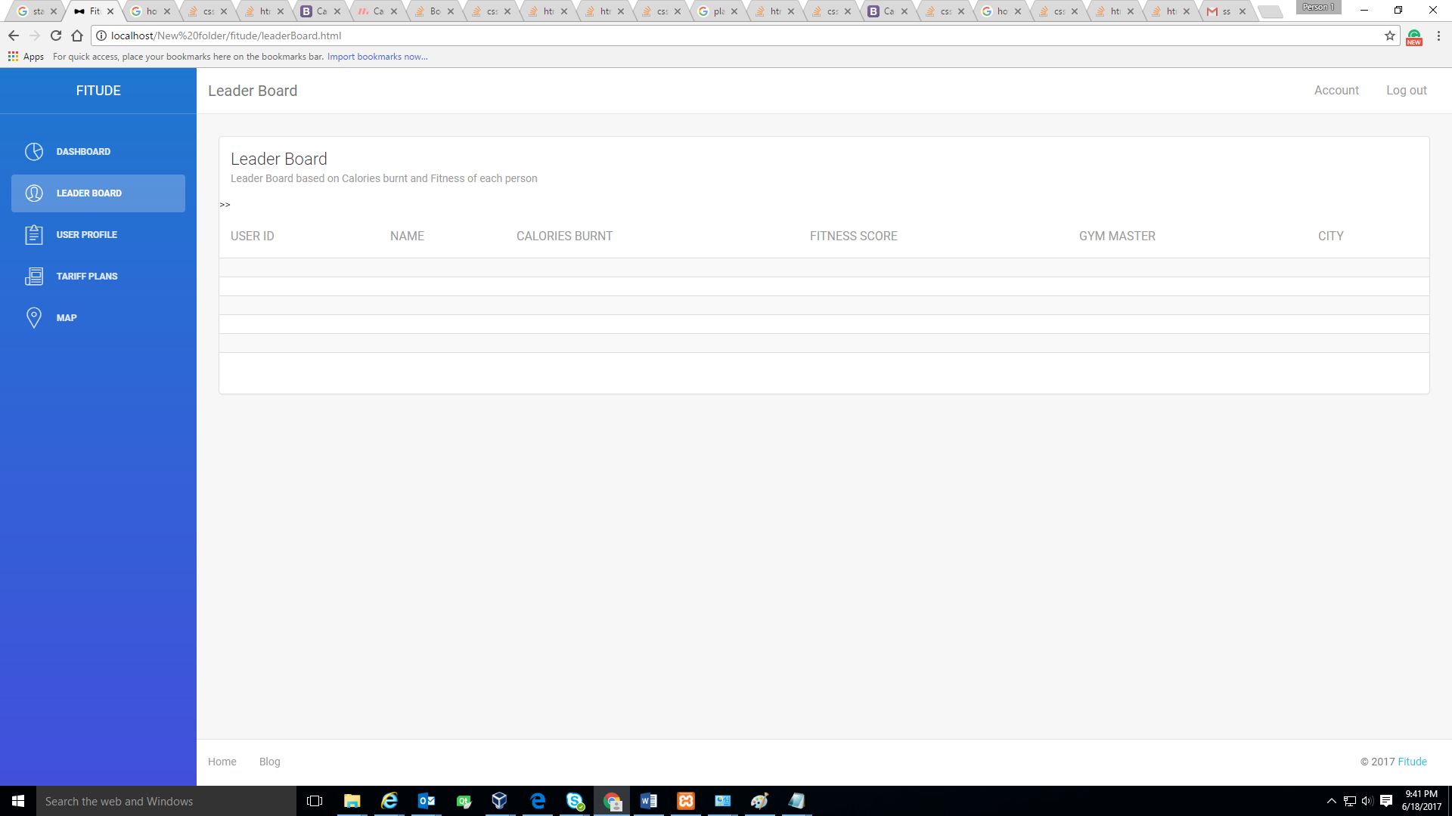

Slide 8
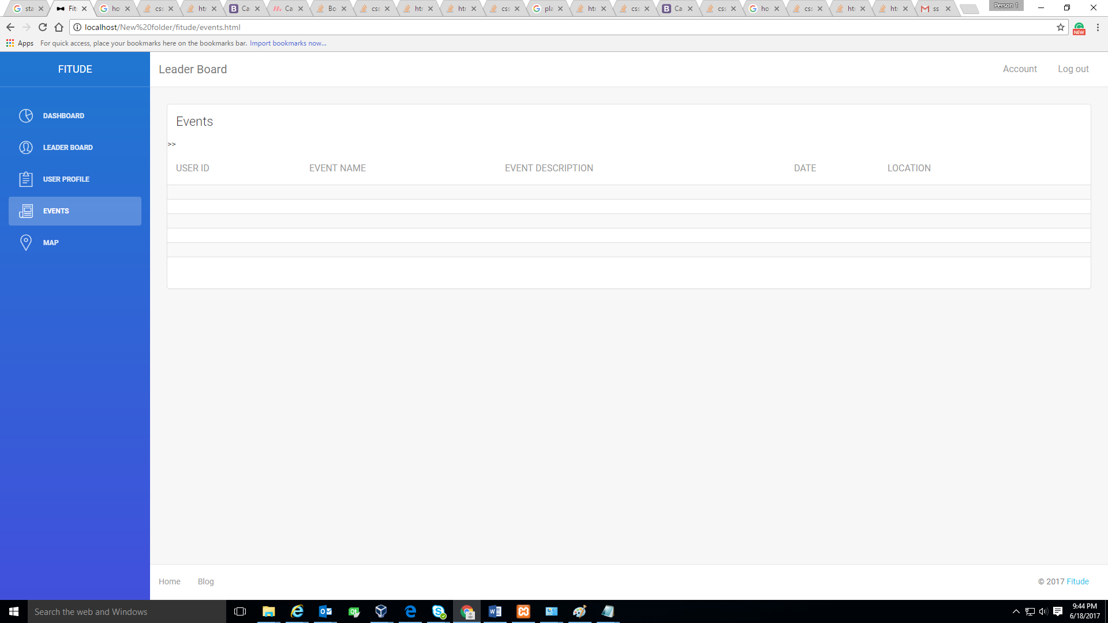

Slide 9
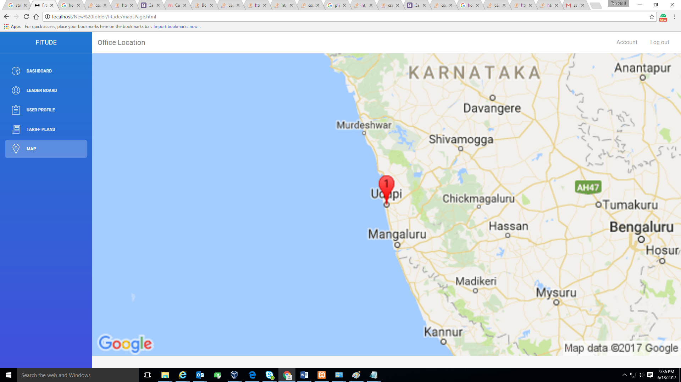

Slide 10
THANK YOU

